Slide 1
The Fantastic Five Team F
Christopher Mahon – Team Leader
Christopher Jerrard-Dunne – Lead designer/coder
Jake Mulholland – Lead documenter
Konrad Jedrol – Lead planner
Jun Hee Jang – Lead Tester

Slide 2
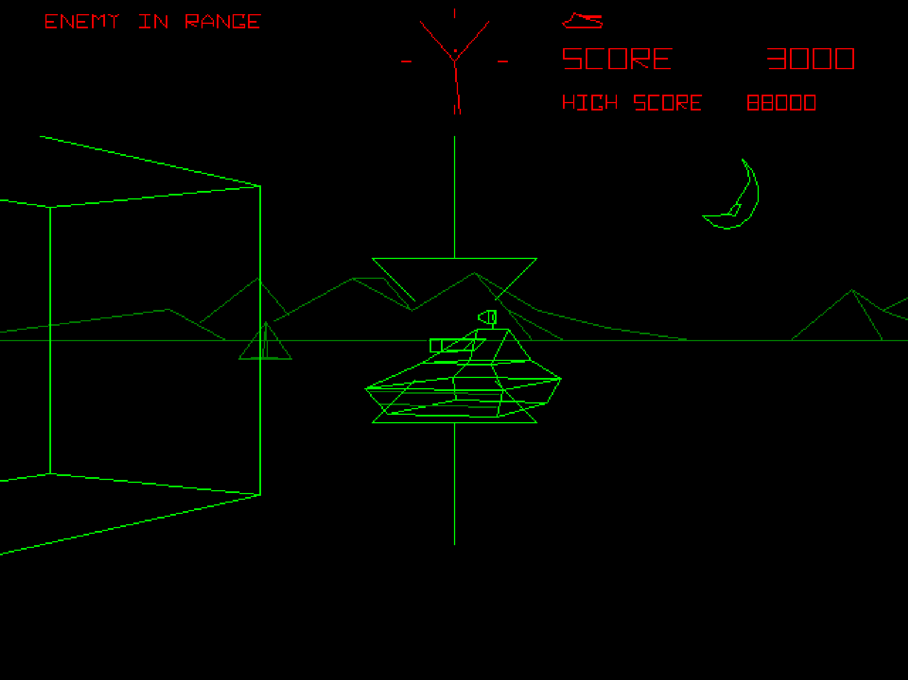
Our Project

Slide 3
Our Requirements
Recreate Battlezone
3D vector based graphics
Kinect support

Slide 4
Our Approach
Prioritised requirements based on functional importance
External requirements were top priority

Slide 5
Our Design in Brief
Maintaining the spirit of the original title
Modernise some aspects about the title
Allow for different control schemes of playing the game

Slide 6
Where did we succeed?
How it looks
Player control
Enemy AI
Level
Environment Interaction
UI elements
Sound

Slide 7
Difficulties faced
Acquiring development tools
Complications with imported custom models
Team Member Availability
Working in a new environment

Slide 8
Addressing Issues
Organised Focused Meetings
Rotated Tasks
Multiple members per task

Slide 9
Approach to Testing
Weekly builds
Tested for each build
Bugs reported and dealt with in the next sprint

Slide 10
Benefits of Teamwork
Lessened workload on an individual basis
Able to play to peoples strengths
Faster progress through the various stages of the project
Allows for multiple critical viewpoints

Slide 11
Downfalls of Teamwork
Progress can greatly suffer with a lack of support from all members
Lack of communication between the team can lead to complications
Can be difficult for those used to solo work

Slide 12
How would we approach this differently
Spend more time development rather then discussing our approach
Rotate tasks that aren’t being completed fast enough
Harsher internal deadlines
More team building

Slide 13
Any Questions?

